Slide 1
Business 2023 Annual Report Infographics
Here is where this template begins

Slide 2
Business 2023 annual report infographics
Core team members
2023
John Doe
Helena James
Rita Davies
Jim Smith
Mercury is the smallest planet
Despite being red, Mars is cold
Jupiter is the biggest planet
Neptune is very far from the Sun

Slide 3
Business 2023 annual report infographics
01
Our mission
Saturn is composed mostly of hydrogen and helium
Company’s mission & vision
02
Our vision
Mercury is the smallest planet of them all
03
Core values
Venus has a very beautiful name, but it’s terribly hot

Slide 4
Business 2023 annual report infographics
Achievements & milestones
05
04
Saturn
03
Saturn is the ringed gas giant
Neptune
02
The farthest planet from the Sun
Jupiter
01
Jupiter is the biggest planet
Mars
Despite being red, Mars is cold
2023
+ 30%
Mercury
Total growth
Mercury is the smallest planet

Slide 5
Business 2023 annual report infographics
01
02
Prospects
Analysis
Jupiter is the biggest planet
Neptune is very far from the Sun
Our process
03
04
Leads
Sales
Mercury is the smallest planet
Despite being red, Mars is cold

Slide 6
Business 2023 annual report infographics
$75M
65%
$60M
$45M
EBITA
Net profit margin
Net revenue
Net Profit
Jupiter is the biggest planet
Neptune is very far from the Sun
Mercury is the smallest planet
Despite being red, Mars is cold

Slide 7
Business 2023 annual report infographics
 | Q1 2023 | Q2 2023 | Q3 2023 | Q4 2023
Shareholders‘ Equity | 529.8 | 1,067.8 | 1,294.6 | 1,632.4
Non–current Liabilities | 535.0 | 548.2 | 513.5 | 989.0
Short–term Borrowings | 439.8 | 622.7 | 720.6 | 1,603.8
Trade Payables | 352.9 | 508.9 | 760.4 | 433.7
Other Current Liabilities | 5.9 | 147.3 | 289.5 | 372.6
Short Term Provisions | 21.4 | 6.2 | 15.0 | 28.0
Current Liabilities | 820.1 | 1,285.0 | 1,785.5 | 2,438.1
Total | 1,760.4 | 2,678.1 | 3,316.3 | 4,730.4

Slide 8
Business 2023 annual report infographics
2023
Mercury is the closest planet to the Sun and the smallest one in the entire Solar System
Q1
Q2
+10%
+70%
Q3
Q4
+60%
Value of investments
+30%
+20%
From 2020

Slide 9
Business 2023 annual report infographics
01
02
Neptune
$9.4M
Jupiter
$6.9M
Neptune is the farthest planet from the Sun
Jupiter is a gas giant and the biggest planet
Interests
Staff costs
03
04
Mars
$7.1M
Mercury
$8.9M
Despite being red, Mars is a cold place
Mercury is the closest planet to the Sun
Depreciation
Rent costs

Slide 10
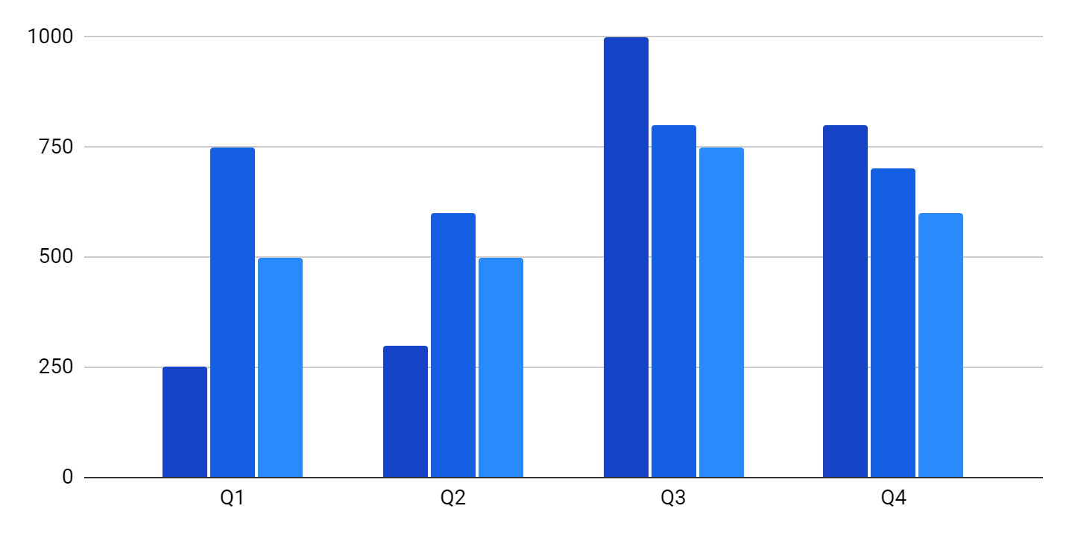
Business 2023 annual report infographics
Neptune
Neptune is the farthest planet from the Sun
Mars
Despite being red, Mars is a cold place
Pluto
Pluto is considered a dwarf planet
Total investment
Operating expenses
Annual budget
$23,350,000
$18,230,000
$8,330,000
Follow the link in the graph to modify its data and then paste the new one here. For more info, click here

Slide 11
Business 2023 annual report infographics
Category | Budget | Expense | Net earnings
Marketing | 3,200 | 1,200 | 1,000
Web | 5,500 | 2,300 | 2,200
Social media | 1,200 | 4,500 | 3,300
Print ads | 4,500 | 2,500 | 2,000
Sponsorship | 5,650 | 5,200 | 450
Spent vs saved
Initial budget
$35,750
Additional expenses
$25,650

Slide 12
Business 2023 annual report infographics
75%
$671 M
Revenue
25%
Jupiter is a gas giant and the biggest planet
2020
2023
Operating profit
Global market share
40.3%
$324 M
Expenses
Mercury is the closest planet to the Sun
Earth is the beautiful planet where we live

Slide 13
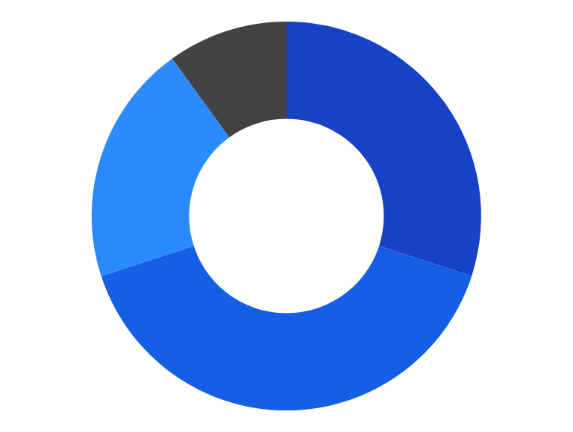
Business 2023 annual report infographics
Sources of funding
Return on investment
$5
Returned
30%
Grants
for every
40%
$1
Invested
Donors
20%
Funds
3,800
10%
Others
New jobs created
Follow the link in the graph to modify its data and then paste the new one here. For more info, click here

Slide 14
Business 2023 annual report infographics
Campaign A
Campaign B
Share of engagement
Followers growth
Followers growth
Campaign A
12%
36%
17%
21,000
New followers
16,000
New followers
4,000
Engagements
3,000
Engagements
Campaign B
67
New posts
54
New posts
14%
8,700
Post likes
6,200
Post likes

Slide 15
Business 2023 annual report infographics
Corporate responsibility
Citizens | $30.152M | $58M | 12% | 1.5M
 | Distribution | Investment | Performance | Training
 | Venus has very high temperatures | Jupiter is the biggest one | Earth is the only planet with rings | Ceres is a famous asteroid
Environment | -21% | A+ | A | -3%
 | Emissions | Water score | Climate score | Water use
 | Despite being red, Mars is cold | Mercury is the smallest planet | Saturn is a big gas giant with rings | Pluto is a very small planet

Slide 16
Business 2023 annual report infographics
Goals
Vision
Key actions
Optimize raw materials
Mercury is the closest planet to the Sun
Key action 1
Key action 2
Key action 3
Culture of innovation
Jupiter is a gas giant and the biggest planet
Key action 1
Key action 2
Key action 3
Quality products
Despite being red, Mars is a cold place
Key action 1
Key action 2
Key action 3
Enhance brand
Venus has a beautiful name, but it’s hot
Key action 1
Key action 2
Key action 3

Slide 17
Business 2023 annual report infographics
February
April
June
Mercury is the closest planet to the Sun
Pluto is considered a dwarf planet
Neptune is very far from the Sun
$32,760
$12,540
$21,760
12 Month
01
02
03
04
05
06
2023 timeline
$23,760
$18,760
$23,760
January
March
May
Jupiter is the biggest planet of them all
Venus has a nice name, but it’s hot
Despite being red, Mars is a cold place

Slide 18
Business 2023 annual report infographics
August
October
December
Mercury is the closest planet to the Sun
Pluto is considered a dwarf planet
Neptune is very far from the Sun
$32,760
$12,540
$21,760
07
08
09
10
11
12
$23,760
$18,760
$23,760
July
September
November
Jupiter is the biggest planet of them all
Venus has a nice name, but it’s hot
Despite being red, Mars is a cold place

Slide 19
Business 2023 annual report infographics
2023 |  | Investment | Benefits | ROI
 | New partners | $1,000 | $3,000 | 2
 | New products | $1,000 | $1,500 | 0.5
 | Enhanced strategies | $2,000 | $4,500 | 1.25

Slide 20
Business 2023 annual report infographics
Financial budget
$70,000
$120,000
$200,000
Mercury is the closest planet to the Sun and the smallest one
Design
Software
Rent
$850,000
$80,000
$800,000
Maintenance
Employees
Per year

Slide 21
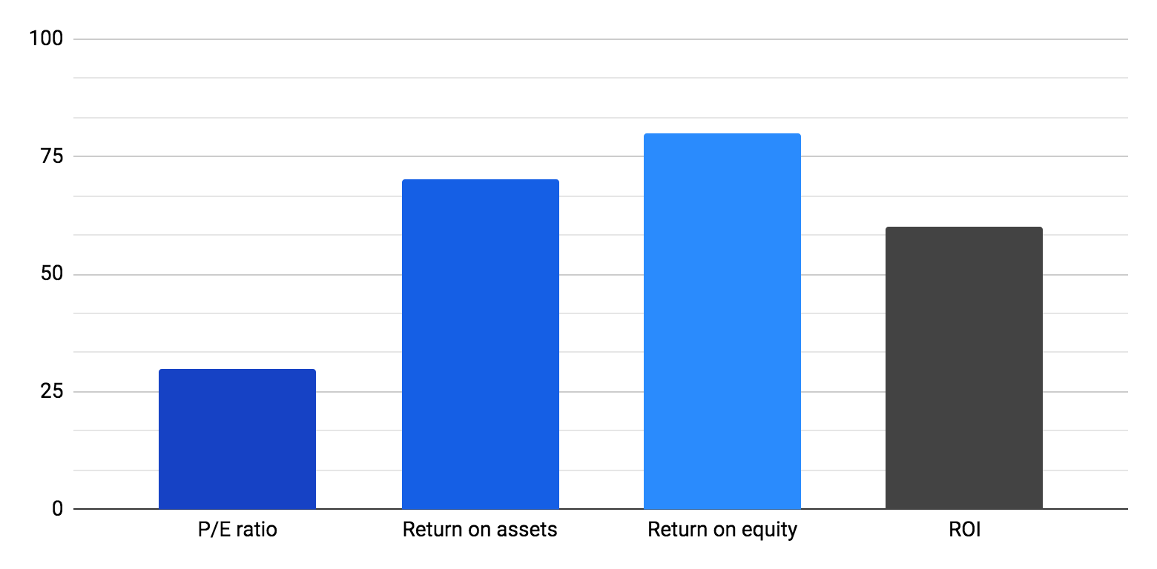
Business 2023 annual report infographics
P/E ratio
Jupiter is a gas giant and the biggest planet
Financial ratios
Return on assets
Mercury is the closest planet to the Sun
Return on equity
Venus has a beautiful name, but it’s hot
Current ratio
Earth is the third planet from the Sun
20%
70%
80%
60%
Follow the link in the graph to modify its data and then paste the new one here. For more info, click here

Slide 22
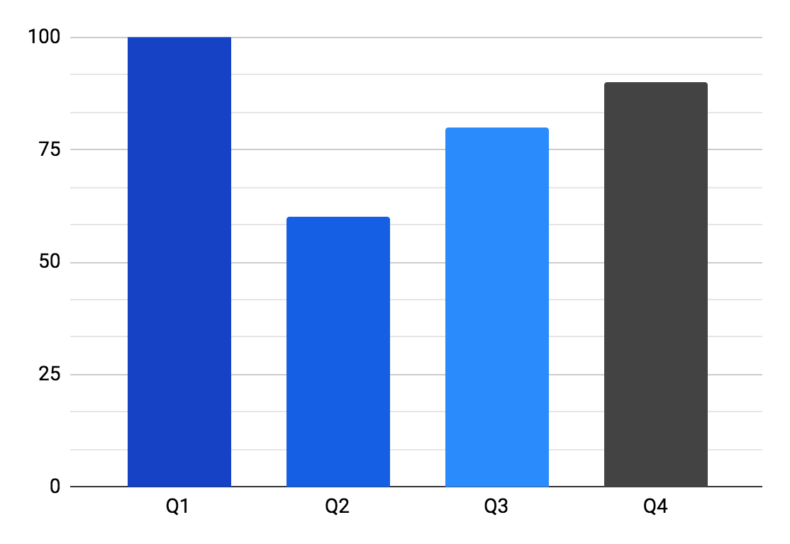
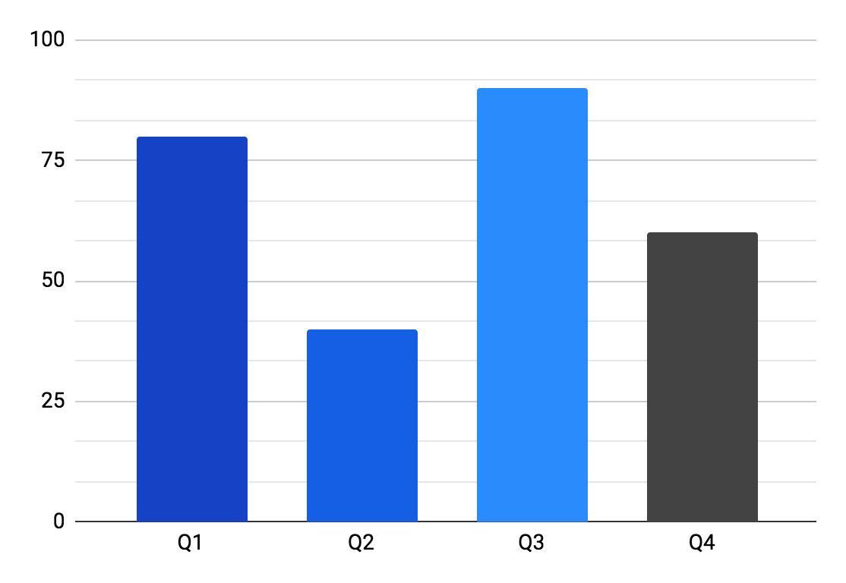
Business 2023 annual report infographics
Revenue
20% Y-o-Y*
COGS
11% Y-o-Y*
Jupiter is a gas giant and the biggest planet
Despite being red, Mars is a very cold place
*Year over year
*Year over year
Follow the link in the graph to modify its data and then paste the new one here. For more info, click here

Slide 23
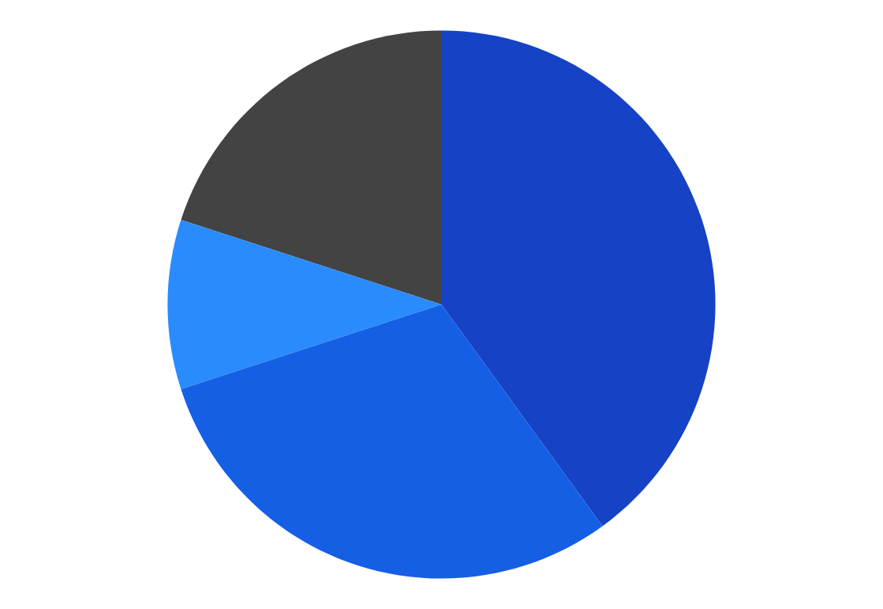
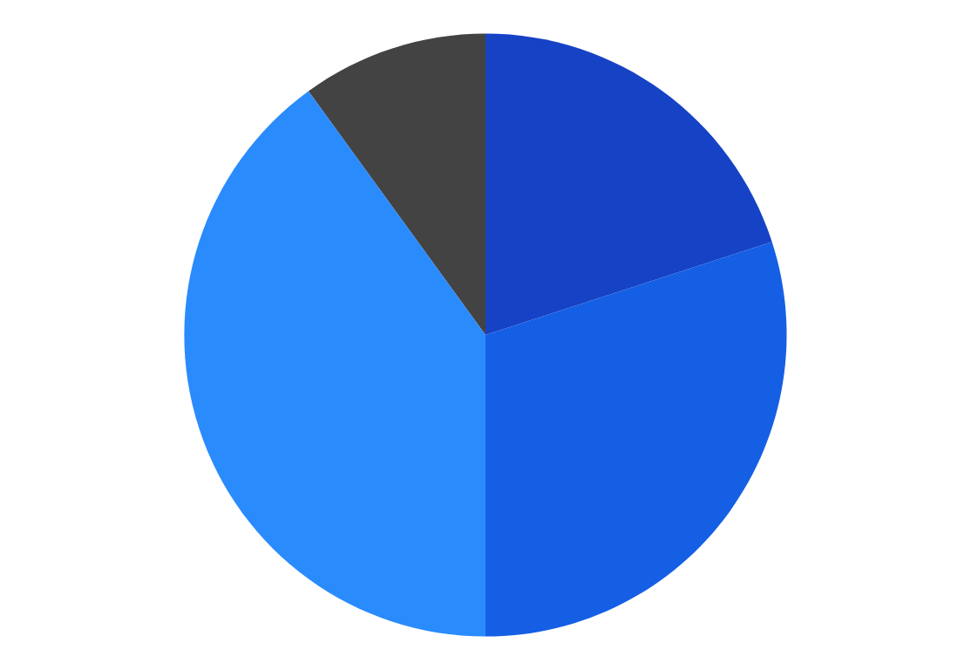
Business 2023 annual report infographics
20%
40%
10%
20%
Q4
Q1
Q4
Q1
10%
30%
40%
30%
Q3
Q2
Q3
Q2
Operating profit
35% Y-o-Y
Net profit
25% Y-o-Y
Jupiter is a gas giant and the biggest planet
Despite being red, Mars is very cold
Follow the link in the graph to modify its data and then paste the new one here. For more info, click here

Slide 24
Business 2023 annual report infographics
2023 | Q1 | Q2 | Q3 | Q4
Net sales | $1,700 | $2,100 | $3,170 | $4,700
Expenses
Cost of goods | $1,200 | $1,370 | $2,000 | $2,200
Employee benefit | $95 | $128 | $155 | $226
EBITDA | $261 | $361 | $746 | $781
%EBITDA | 15% | 17% | 23% | 22%
Financing cost | $70 | $128 | $190 | $273
PAT | $165 | $187 | $350 | $336
%PAT | 9.5% | 9.2% | 11% | 9.6%

Slide 25
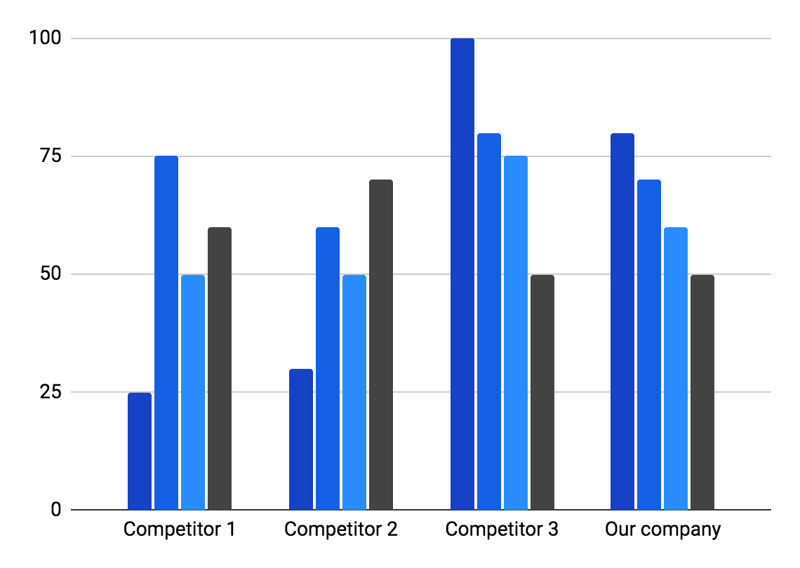
Business 2023 annual report infographics
$347,750,000
Return on investment
Revenue increase
Gross margin
Jupiter is a gas giant and the biggest planet
Mercury is the closest planet to the Sun
Annual cost
ROI dollars
Neptune is the farthest planet from the Sun
Despite being red, Mars is really a very cold place
90%
70%
40%
80%
Follow the link in the graph to modify its data and then paste the new one here. For more info, click here

Slide 26
Business 2023 annual report infographics
Revenue | Gross sales | $2,456
 | Sales discounts | $7,123
Cost of goods sold | Raw materials inventory | $2,322
 | Raw materials purchases | $1,434
Cost of raw materials | Raw materials used | $3,562
 | Added materials | $6,675
Add direct costs | Direct labor costs | $2,546
 | Direct utility costs | $6,756

Slide 27
Business 2023 annual report infographics
Expenses | January—June | July—December
Wages | $4,000 | $1,000
Rent | $2,000 | $1,000
Electricity | $2,000 | $10,000
Total expenses | $8,000 | $12,000
 | Income | January—June | July—December
 | Income 1 | $8,000 | $8,000
 | Income 2 | $10,000 | $20,000
 | Income 3 | $8,000 | $10,000
 | Total income | $26,000 | $38,000

Slide 28
Business 2023 annual report infographics
Q1 | Q2 | Q3 | Q4 | 2023
3,540 | 5,198 | 1,450 | 7,430 |  | Sales
1,450 | 2,250 | 1,000 | 3,200 |  | Cost of goods sold
2,000 | 2,000 | 7,430 | 3,000 |  | Gross profit
7,430 | 1,543 | 5,198 | 5,400 |  | Indirect expenses
2,250 | 1,250 | 2,500 | 2,340 |  | Net profit before tax
6,400 | 2,250 | 1,450 | 5,198 |  | Provision for tax
7,500 | 3,500 | 3,000 | 5,000 |  | Net profit after tax

Slide 29
Business 2023 annual report infographics
2023
Saturn is a gas giant and has several rings. It's composed mostly of hydrogen and helium
Goals
25% | 75%
Pluto | Ceres
Pluto is considered a dwarf planet | Ceres is located in the main asteroid belt
Milestones
May 21st | Venus has a nice name
June 23th | Mars is a very cold planet
July 16th | Jupiter is the biggest planet
August 12th | Mercury is the smallest one
September 11th | Only saturn has rings

Slide 30
Business 2023 annual report infographics
2023 Costs
Concept | Quantity | Price
Venus | 10 | $400
Mars | 5 | $7,000
Earth | 5 | $3,000
Moon | 15 | $50
Total | $10,450
2023 milestones
01
Jupiter
Jupiter is a gas giant
02
Pluto
It’s a dwarf planet
03
Earth
It harbours life
04
Saturn
Saturn has rings

Slide 31
Business 2023 annual report infographics
Export
Revenue
60 %
Mercury is the closest planet to the Sun and the smallest one in the entire Solar System
10 %
30 %
50%
60%
40%
Jupiter
Neptune
Venus
Asia
America
Europe

Slide 32
Business 2023 annual report infographics
Leadership
Operations
Marketing
2023 | Jan | Feb | Mar | Apr | May | Jun | Jul | Aug | Sep | Oct | Nov | Dec
Pluto is considered a dwarf planet
Ceres is located in the main asteroid belt
Neptune is composed of hydrogen and helium
25%
45%
50%
Venus
Mercury
Jupiter
Venus has a beautiful name, but it’s hot
Mercury is the closest planet to the Sun
Jupiter is a gas giant and the biggest planet

Slide 33
Instructions for use
In order to use this template, you must credit Slidesgo in your final presentation.
You are allowed to:
- Modify this template.
- Use it for both personal and commercial projects.
You are not allowed to:
- Sublicense, sell or rent any of Slidesgo Content (or a modified version of Slidesgo Content).
- Distribute Slidesgo Content unless it has been expressly authorized by Slidesgo.
- Include Slidesgo Content in an online or offline database or file.
- Offer Slidesgo templates (or modified versions of Slidesgo templates) for download.
- Acquire the copyright of Slidesgo Content.
For more information about editing slides, please read our FAQs or visit Slidesgo School:
https://slidesgo.com/faqs and https://slidesgo.com/slidesgo-school

Slide 34
Instructions for use (premium users)
In order to use this template, you must be a Premium user on Slidesgo.
You are allowed to:
Modify this template.
Use it for both personal and commercial purposes.
Hide or delete the “Thanks” slide and the mention to Slidesgo in the credits.
Share this template in an editable format with people who are not part of your team.
You are not allowed to:
Sublicense, sell or rent this Slidesgo Template (or a modified version of this Slidesgo Template).
Distribute this Slidesgo Template (or a modified version of this Slidesgo Template) or include it in a database or in any other product or service that offers downloadable images, icons or presentations that may be subject to distribution or resale.
Use any of the elements that are part of this Slidesgo Template in an isolated and separated way from this Template.
Register any of the elements that are part of this template as a trademark or logo, or register it as a work in an intellectual property registry or similar.
For more information about editing slides, please read our FAQs or visit Slidesgo School:
https://slidesgo.com/faqs and https://slidesgo.com/slidesgo-school

Slide 35
Infographics
You can add and edit some infographics to your presentation to present your data in a visual way.
Choose your favourite infographic and insert it in your presentation using Ctrl C + Ctrl V or Cmd C + Cmd V in Mac.
Select one of the parts and ungroup it by right-clicking and choosing “Ungroup”.
Change the color by clicking on the paint bucket.
Then resize the element by clicking and dragging one of the square-shaped points of its bounding box (the cursor should look like a double-headed arrow). Remember to hold Shift while dragging to keep the proportions.
Group the elements again by selecting them, right-clicking and choosing “Group”.
Repeat the steps above with the other parts and when you’re done editing, copy the end result and paste it into your presentation.
Remember to choose the “Keep source formatting” option so that it keeps the design. For more info, please visit Slidesgo School.

